Slide 1
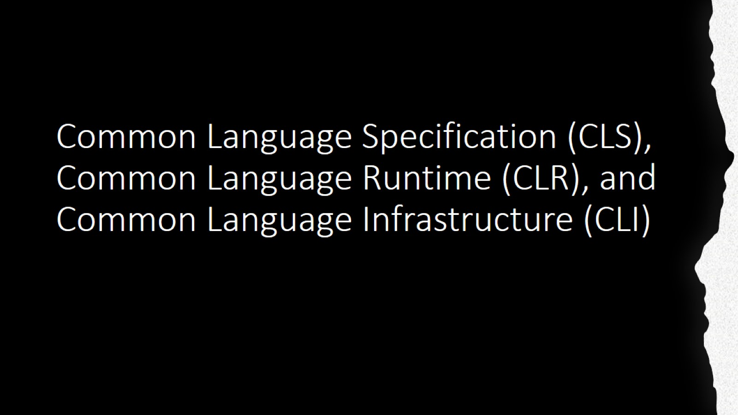
Common Language Specification (CLS), Common Language Runtime (CLR), and Common Language Infrastructure (CLI)

Slide 2
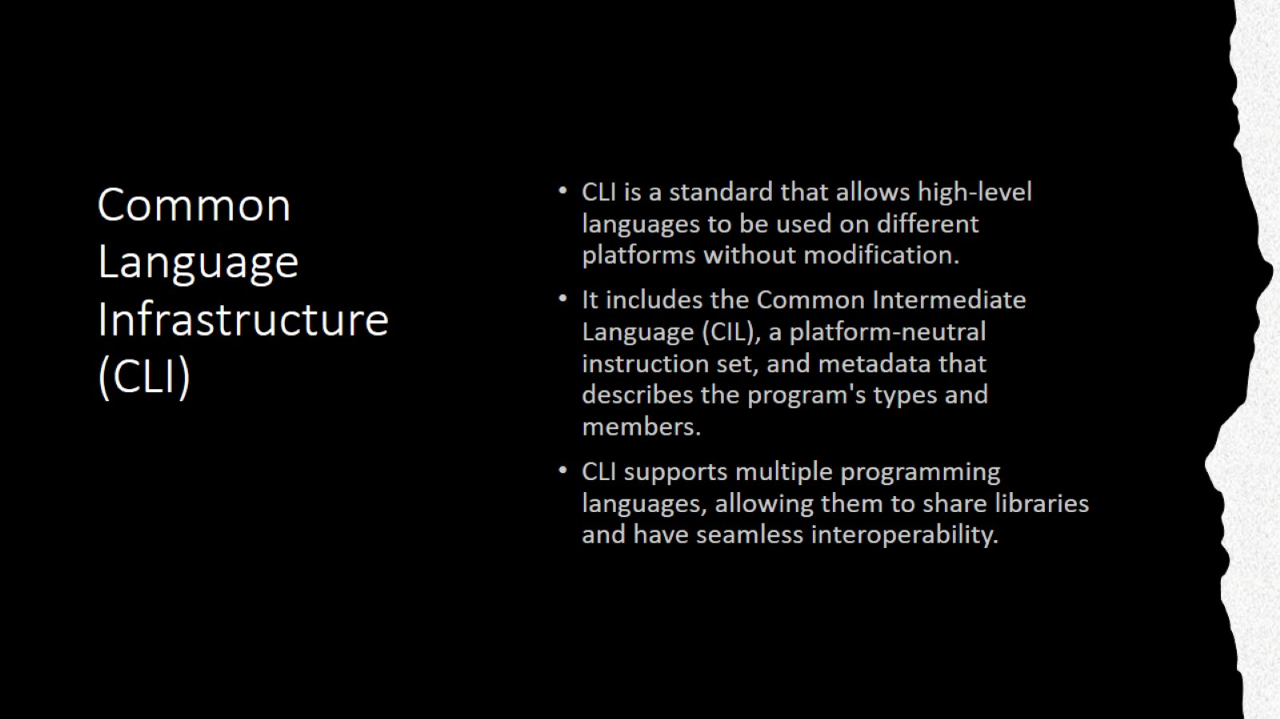
Common Language Infrastructure (CLI)

Slide 3
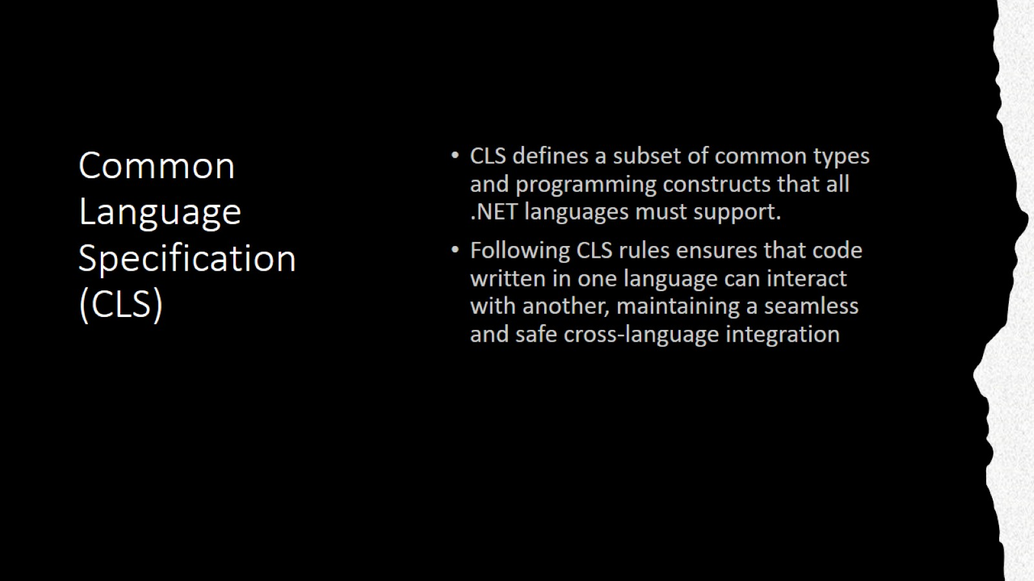
Common Language Specification (CLS)

Slide 4
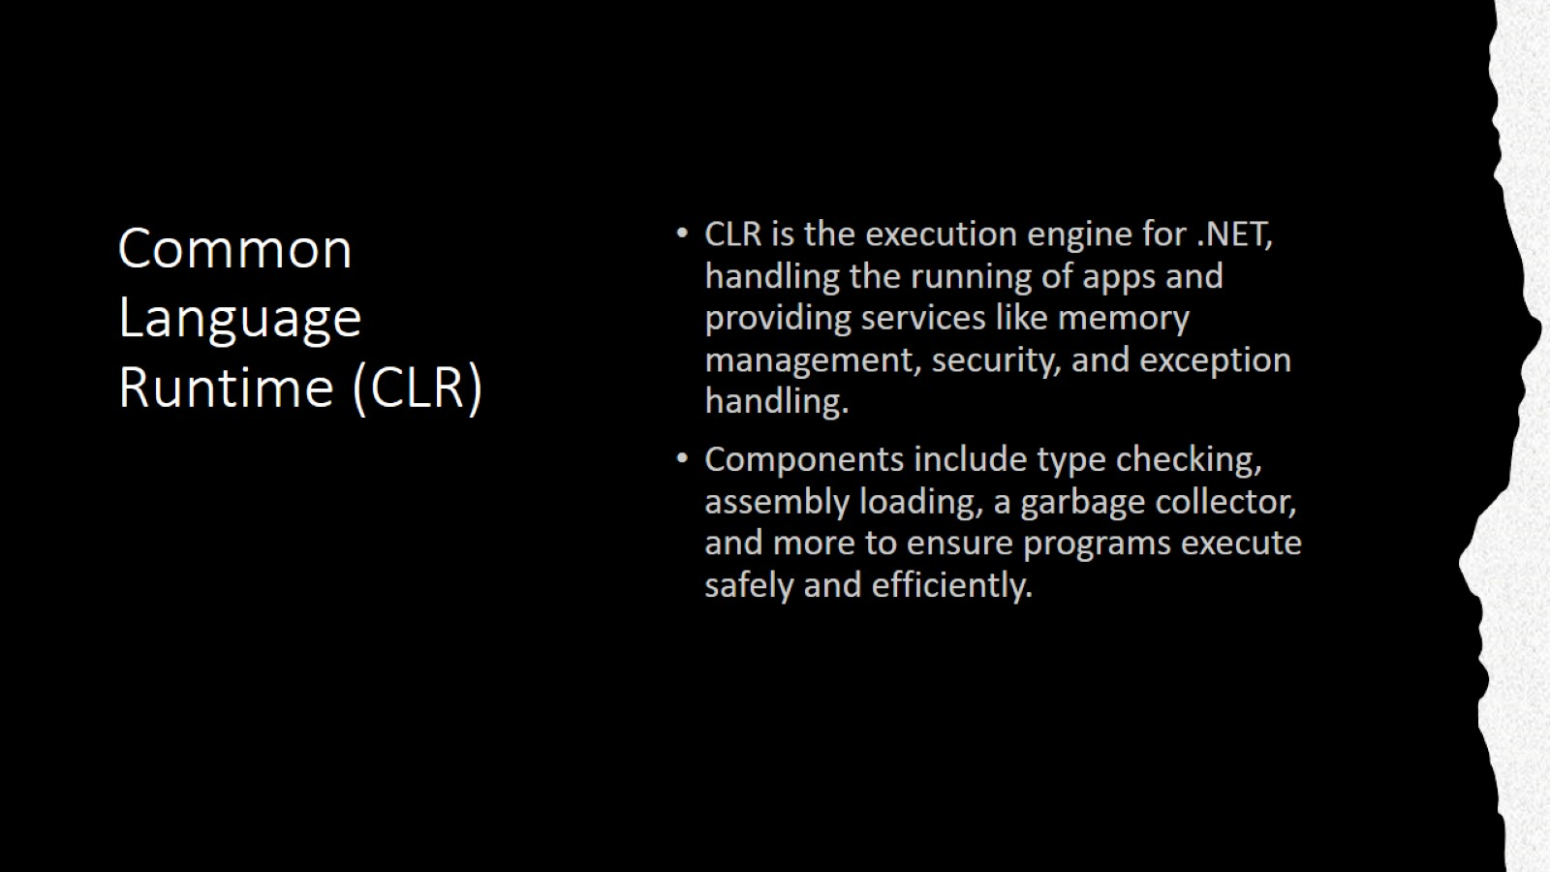
Common Language Runtime (CLR)

Slide 5
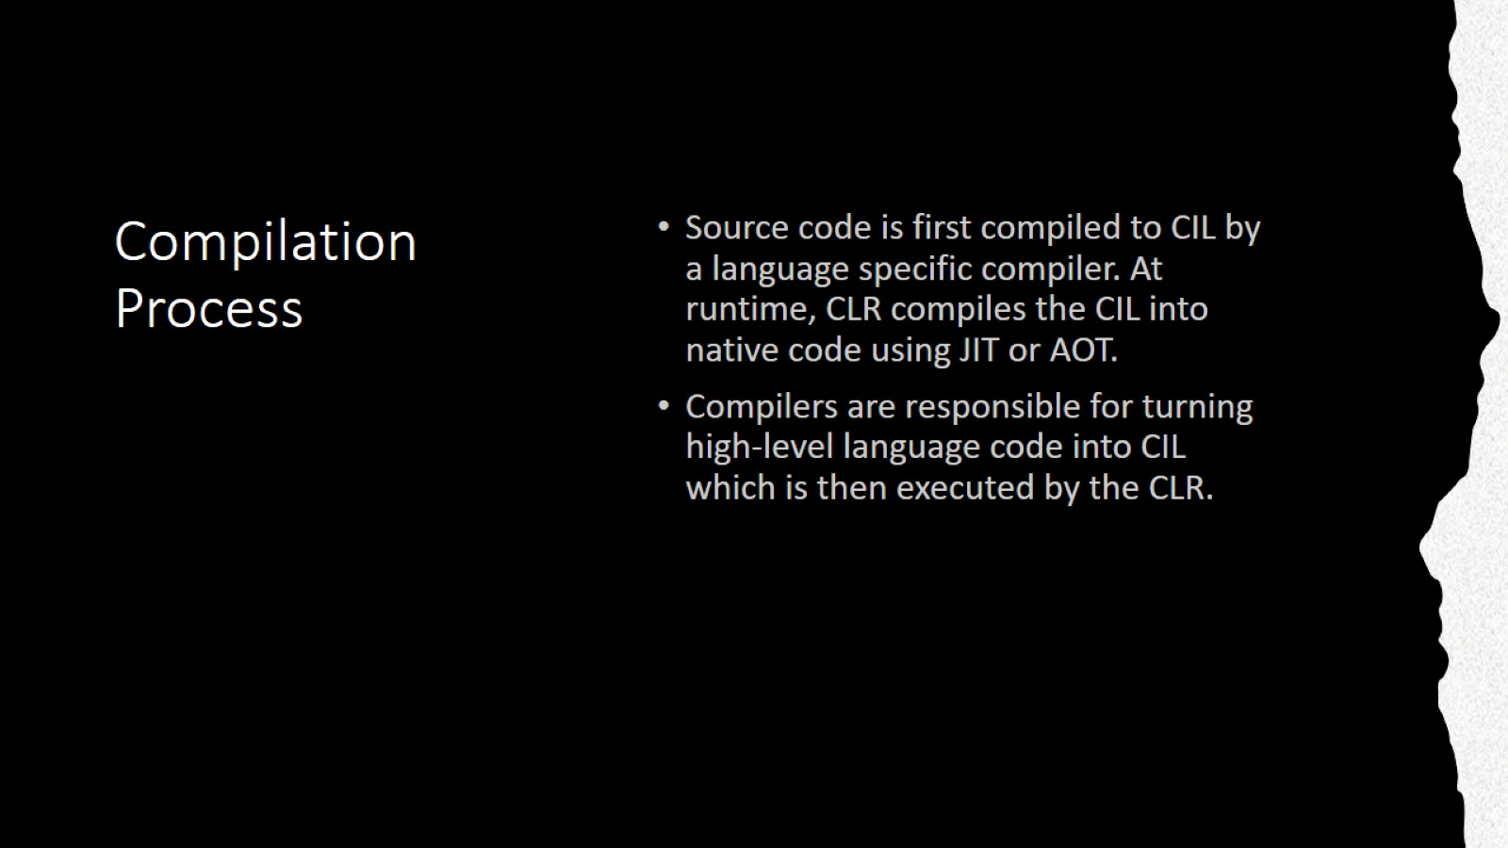
Compilation Process

Slide 6
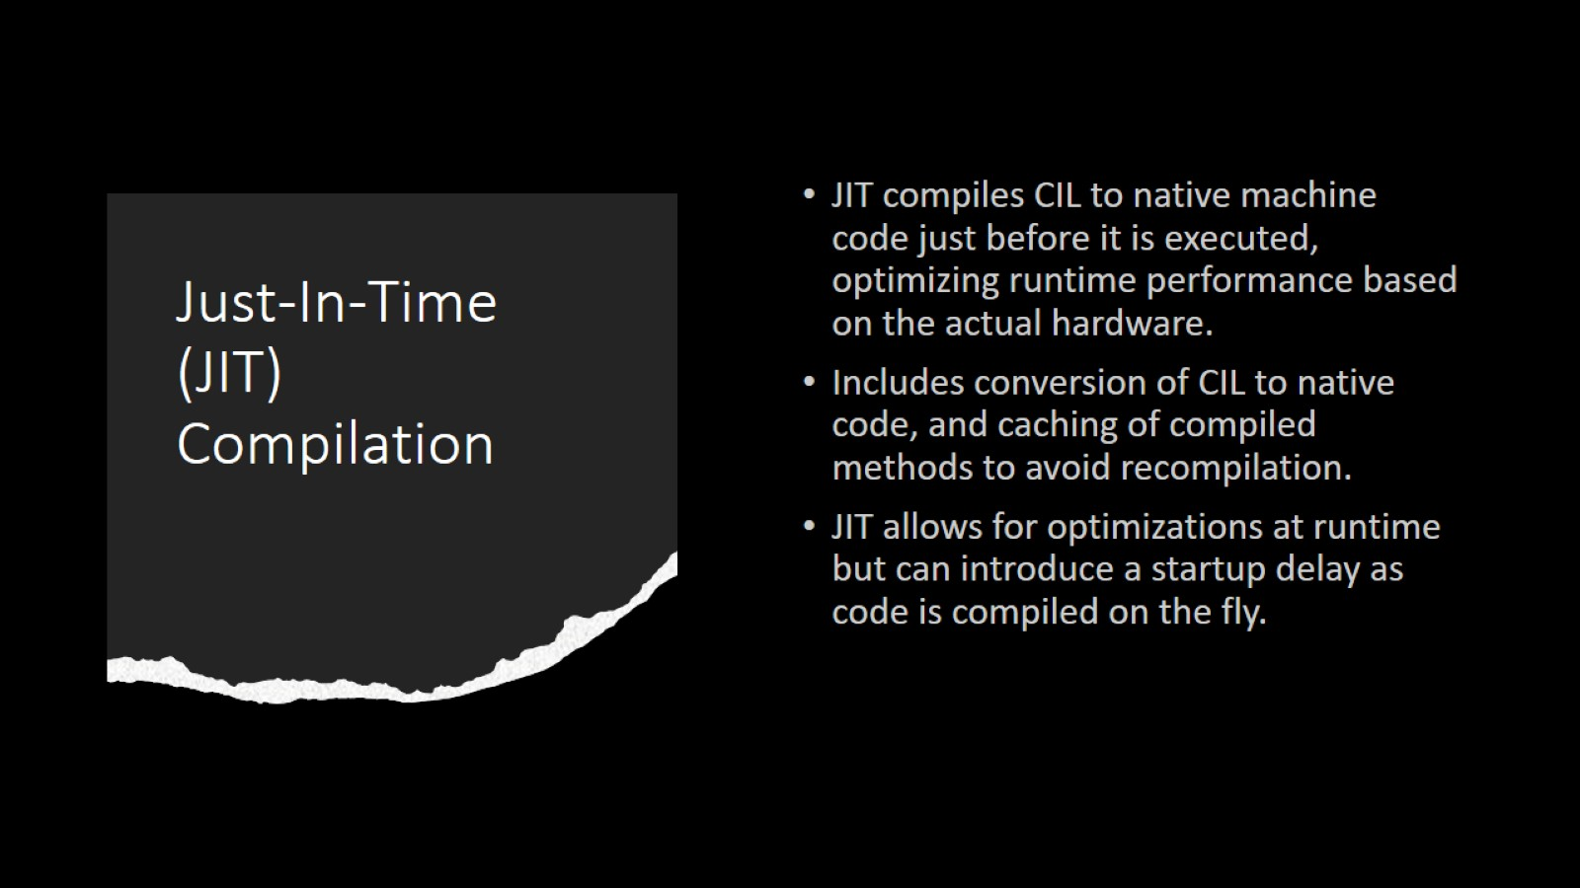
Just-In-Time (JIT) Compilation

Slide 7
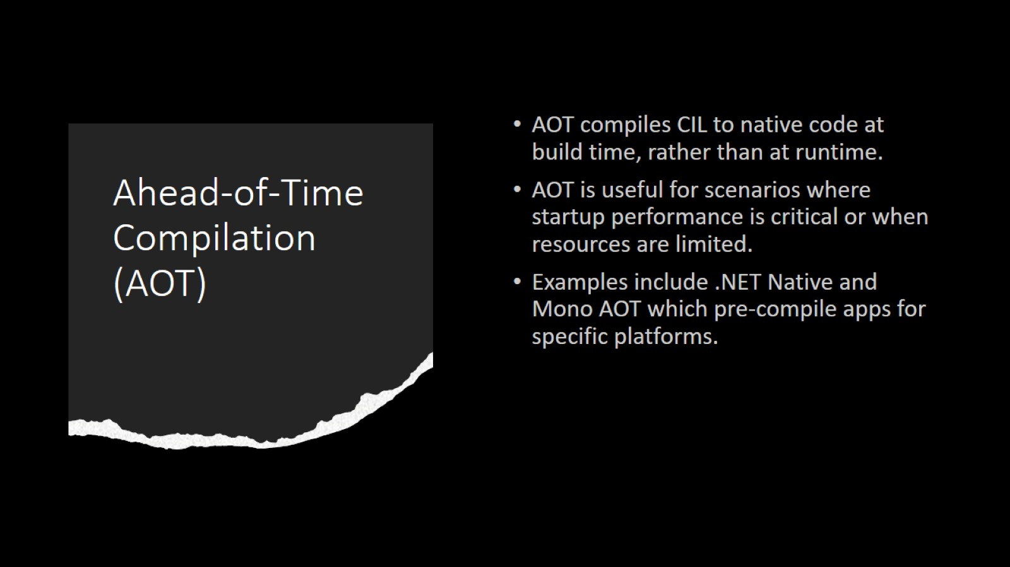
Ahead-of-Time Compilation (AOT)

